Slide 1
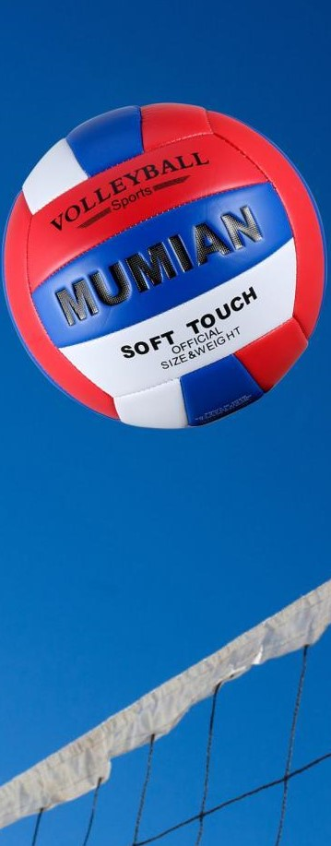
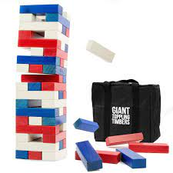
Westside High School
Jan 23-27 Week At a Glance (WAG)

Slide 2
Coach Thomas
Rec. Games: Jan 23-27

Slide 3
Monday - Agenda
Learning Target
I can use proper technique for stretching
I can use strategy to compete in relay while also working as a team
Jan 23
Standard:
Opening ( 10-15 mins)
Student will go through stretches with coaches lead
Work-session ( 20 - 25 mins)
Coach will provide instructions and rules for tic tac toe and flip cup relay
Students will work in groups to complete in relay races
*Losers will have 15 push ups
Criteria for Success
1. Students will work together to compete in relay while using strategy to win
Closing ( 05 – 10 mins)
Cool down

Slide 4
Tuesday - Agenda
Learning Target
Jan. 24th Standard:
PERG.1 The physically educated student demonstrates competency in a variety of motor skills and movement patterns.
a. Demonstrates competence while performing skills in a variety of recreational game settings and activities
b. Performs skills at a level of competence, which contributes to health-related fitness.
c. Demonstrates proper warm-up and cool-down protocol associated with different life time
sport physical activities.
PERG. 2 The physically educated student applies the knowledge of concepts, principles, strategies, and tactics related to movement and performance.
Integrates a variety of strategies, tactics, concepts, and skills during recreational games activities
Evaluates skills needed for recreational games and leisure activities
PERG.3 The physically educated student demonstrates knowledge and skills to help achieve
and maintain a health-enhancing level of physical activity and fitness.
a. Maintains or improves fitness level by using the results of the Georgia Fitness Assessment
to guide changes in a personal program of physical activity.
b. Uses technologies to assess, enhance, and maintain health-related and skill-related fitness.
c. Analyzes the relationship between physical activity and longevity.
Personal and Social Behavior, Rules, Safety, and Etiquette
I can use the proper techniques to do the following
-stretch, complete circuit exercises,
2. I can compete as a team and follow game rules of “Chico”
Opening ( 10-15 mins)
5-10 minute static & dynamic stretches (5 minutes locker rooms)
Work-session ( 20 - 25 mins)
30 seconds each exercise circuit or tic tac toe & flip cup relay
Teacher will provide rules of Chico and students will work together as teams to compete
Criteria for Success
Students are able to use team strategy to compete in game of Chico
Closing ( 05 – 10 mins)
locker room unlocked for 5 minutes
-students use remaining time to cool down & rehydrate if necessary

Slide 5
Wednesday - Agenda
Learning Target
Jan 25 ^{th} Standard:
PERG.1 The physically educated student demonstrates competency in a variety of motor skills and movement patterns.
a. Demonstrates competence while performing skills in a variety of recreational game settings and activities
b. Performs skills at a level of competence, which contributes to health-related fitness.
c. Demonstrates proper warm-up and cool-down protocol associated with different life time
sport physical activities.
PERG. 2 The physically educated student applies the knowledge of concepts, principles, strategies, and tactics related to movement and performance.
Integrates a variety of strategies, tactics, concepts, and skills during recreational games activities
Evaluates skills needed for recreational games and leisure activities
PERG.3 The physically educated student demonstrates knowledge and skills to help achieve
and maintain a health-enhancing level of physical activity and fitness.
a. Maintains or improves fitness level by using the results of the Georgia Fitness Assessment
to guide changes in a personal program of physical activity.
b. Uses technologies to assess, enhance, and maintain health-related and skill-related fitness.
c. Analyzes the relationship between physical activity and longevity.
Personal and Social Behavior, Rules, Safety, and Etiquette
Same as previous
Opening ( 10-15 mins)
10 minute Walk & Attendance
Work-session ( 20 - 25 mins)
Same as previous day
Coach will Create tournament brackets with teams for Chico competition
Criteria for Success
Closing ( 05 – 10 mins)
Same as previous day.
-locker room unlocked for 5 minutes
-students use remaining time to cool down & rehydrate if necessary

Slide 6
Thursday - Agenda
Learning Target
Same as Tuesday & Wednesday
Jan 26th Standard:
PERG.1 The physically educated student demonstrates competency in a variety of motor skills and movement patterns.
a. Demonstrates competence while performing skills in a variety of recreational game settings and activities
b. Performs skills at a level of competence, which contributes to health-related fitness.
c. Demonstrates proper warm-up and cool-down protocol associated with different life time
sport physical activities.
PERG. 2 The physically educated student applies the knowledge of concepts, principles, strategies, and tactics related to movement and performance.
Integrates a variety of strategies, tactics, concepts, and skills during recreational games activities
Evaluates skills needed for recreational games and leisure activities
PERG.3 The physically educated student demonstrates knowledge and skills to help achieve
and maintain a health-enhancing level of physical activity and fitness.
a. Maintains or improves fitness level by using the results of the Georgia Fitness Assessment
to guide changes in a personal program of physical activity.
b. Uses technologies to assess, enhance, and maintain health-related and skill-related fitness.
c. Analyzes the relationship between physical activity and longevity.
Personal and Social Behavior, Rules, Safety, and Etiquette
Opening ( 10-15 mins)
Static & Dynamic stretching
Work-session ( 20 - 25 mins)
Same as previous day: complete tournament
Criteria for Success
Closing ( 05 – 10 mins)
Same as previous day
-locker room unlocked for 5 minutes
-students use remaining time to cool down & rehydrate if necessary

Slide 7
Friday - Agenda
Learning Target
Jan. 27th Standard:
PERG.1 The physically educated student demonstrates competency in a variety of motor skills and movement patterns.
a. Demonstrates competence while performing skills in a variety of recreational game settings and activities
b. Performs skills at a level of competence, which contributes to health-related fitness.
c. Demonstrates proper warm-up and cool-down protocol associated with different life time
sport physical activities.
PERG.3 The physically educated student demonstrates knowledge and skills to help achieve
and maintain a health-enhancing level of physical activity and fitness.
a. Maintains or improves fitness level by using the results of the Georgia Fitness Assessment
to guide changes in a personal program of physical activity.
b. Uses technologies to assess, enhance, and maintain health-related and skill-related fitness.
c. Analyzes the relationship between physical activity and longevity.
Personal and Social Behavior, Rules, Safety, and Etiquette
Freestyle Friday
Opening ( 10-15 mins)
Attendance
Work-session ( 20 - 25 mins)
Students are able to engage in various activities/sports typically those that they are most interested
Teacher will conference will students and possibly make parent phone calls/contact as needed
Criteria for Success
I can demonstrate my understanding of the rules, procedures, and expectations by following them during class time and asking questions to teacher if necessary.
Closing ( 05 – 10 mins)
N/A

Slide 8
Resources
https://www.youtube.com/watch?v=az_oouQa6VY

